Slide 1
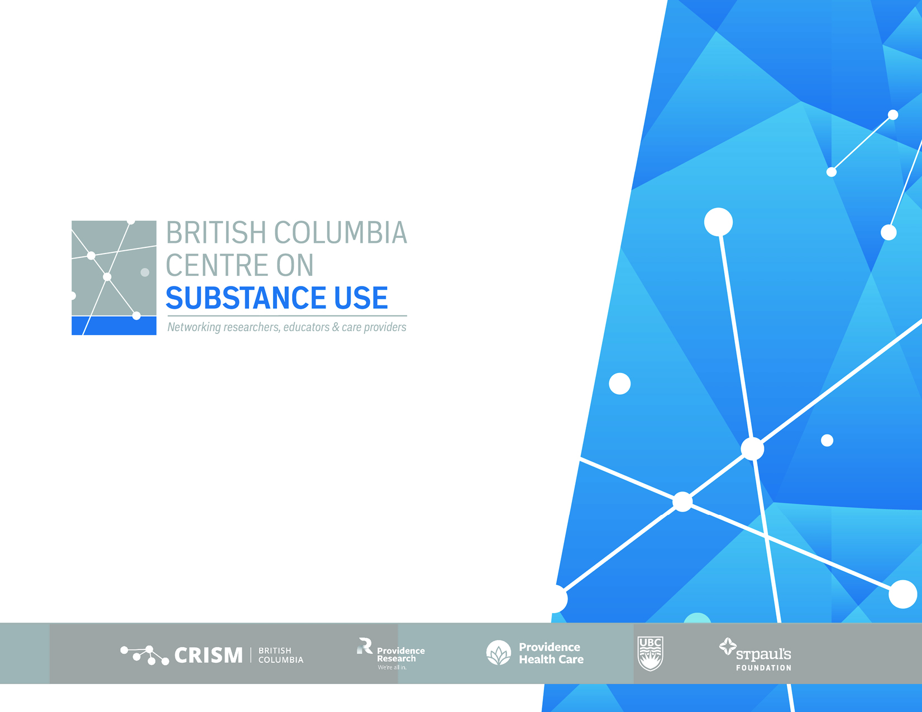
Using drug checking data to assess geographic and temporal trends in fentanyl concentration in BC, 2022-2024
Joshua Bird
27 February 2025
Notes:
Historically high levels of drug mortality/morbidity in BC
Drug checking (DCS) implemented as harm reduction measure in XXXX
Emerging evidence about utility for monitoring population-level risk

Slide 2
Preamble
Disclaimer: No conflicts of interest
Acknowledgement: Exist on the unceded territories of Coast Salish Peoples
Overdose rates ~5-8 times greater than non-Indigenous people
Notes:
Shocking imbalance in overdose harms experienced by Indigenous people,

Slide 3
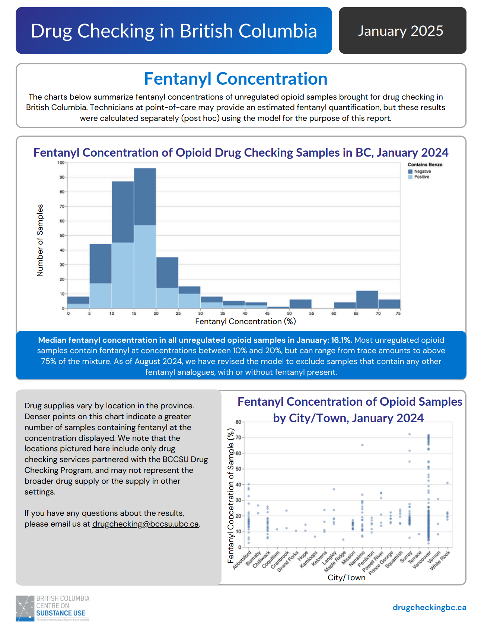
https://drugcheckingbc.ca/monthly-data/
Notes:
BCCSU publishes monthly reports on drug checking, so these are high-level reports containing a wealth of data, any information you could collect from drug checking is in there. The aim of this discussion is to narrow the aperture and focus more deeply on one aspect, which is on fentanyl concentration. So that’s the unique contribution of this work
I would consider adding the graph of fent conc from the monthly PH reports bc ppl will be familiar with this, and then talk about how this presentation is going into this a bit deeper. This is what the unique contribution of your work is

Slide 4
Objective: Describe geographic and temporal trends in fentanyl concentration in British Columbia

Slide 5
Methods
Fentanyl concentration quantification model
FTIR spectroscopy
Quantitatively analyses spectra to determine component concentrations
Excludes samples with analogues
Notes:
To do this, QUANT 2 utilizes a partial least squares fit method, which correlates spectral intensity in specified wavelength regions with values that were generated from reference entries (i.e., point-of-care FTIR scans later quantified via qNMR)
Excludes samples that included other analogues
Using percent-by-weight results of fentanyl hydrochloride determined by qNMR, a quantification model using QUANT 2 (Bruker) software was created to more accurately quantify relative fentanyl concentrations by FTIR spectroscopy. QUANT 2 is a validated software add-on to the spectroscopic analysis program OPUS (version 7.8.44; Bruker) that is used for drug checking and allows for the development of chemometric models. The QUANT 2 software allows for multivariable calibration analysis and is designed to quantitatively analyze spectra to determine component concentrations (31).

Slide 6
Dataset - time
Time series: 1 Jan 2022 – 31 Dec 2024
Notes:
These data were drawn from

Slide 7
Dataset - samples
All drug checking samples
= 106,833
Fentanyl-expected samples
= 37,021
Fentanyl-positive samples
= 36,779
Fentanyl-positive samples (w/o analogues*)
= 13,764 unique samples

Slide 8
Dataset: sites
93 unique sites:
Brick and mortar DCS
Integration with other services (SCS/OPS, needle exchanges
Shelters/housing units
Mobile units
Music festivals/events

Slide 9
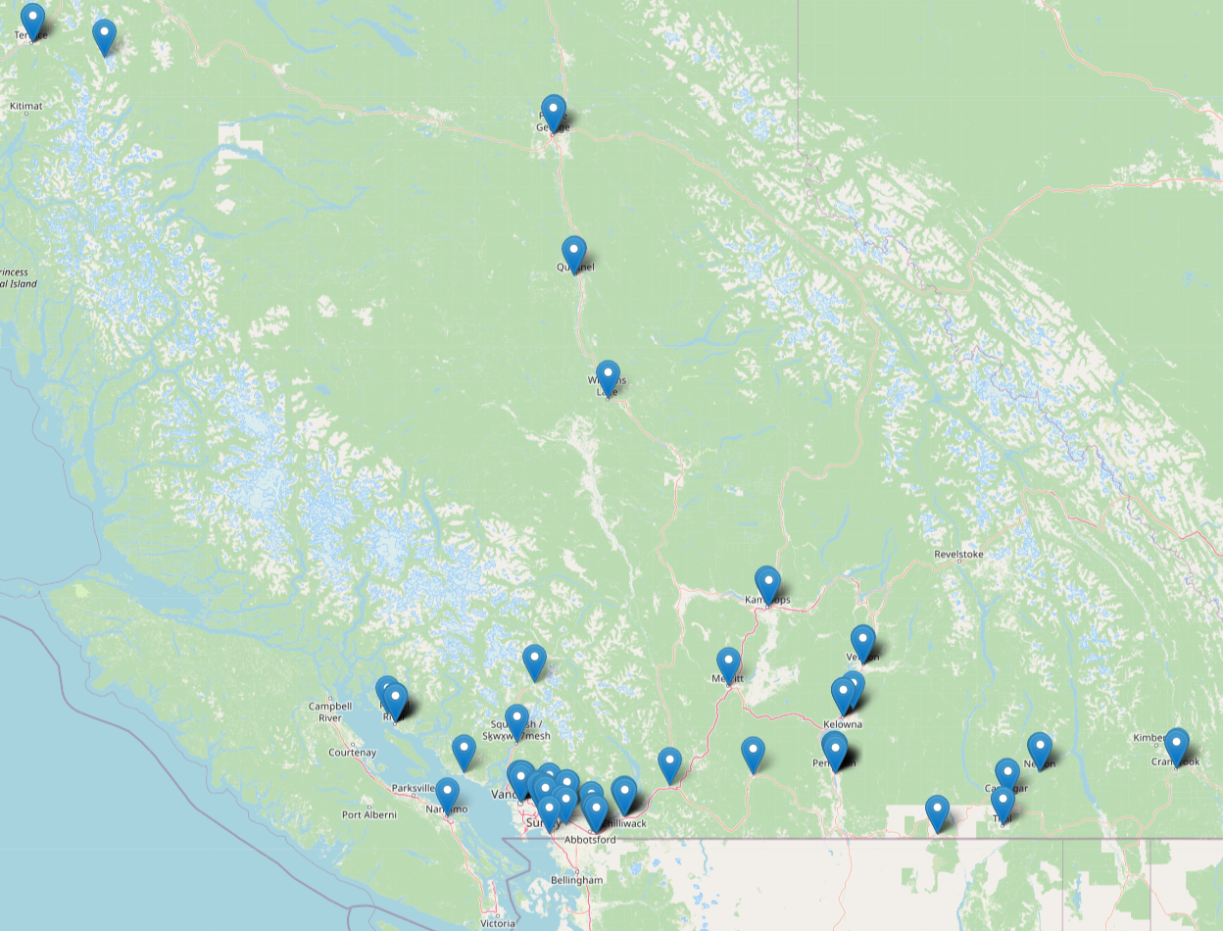
Notes:
These are not all currently extant

Slide 10
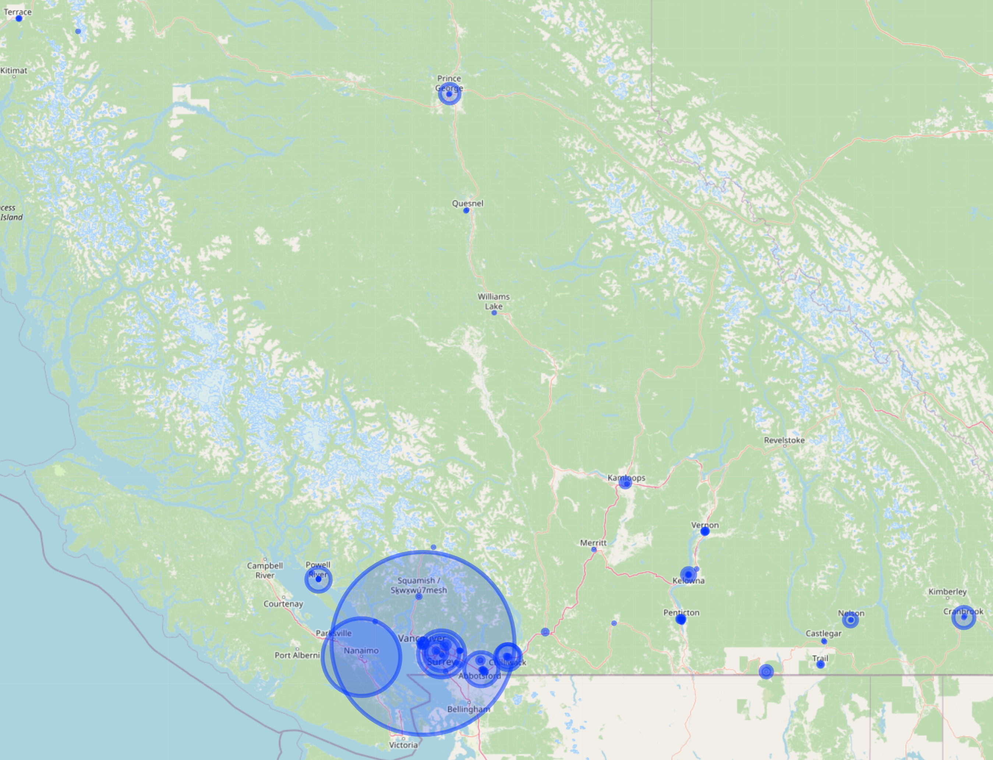
Notes:
These circles are sized based on the number of samples tested and I had to scale the radii down to one half of one percent of their original size, lest the blue blot out the entire map

Slide 11
RESULTS

Slide 12
RESULTS – Health Authority

Slide 13
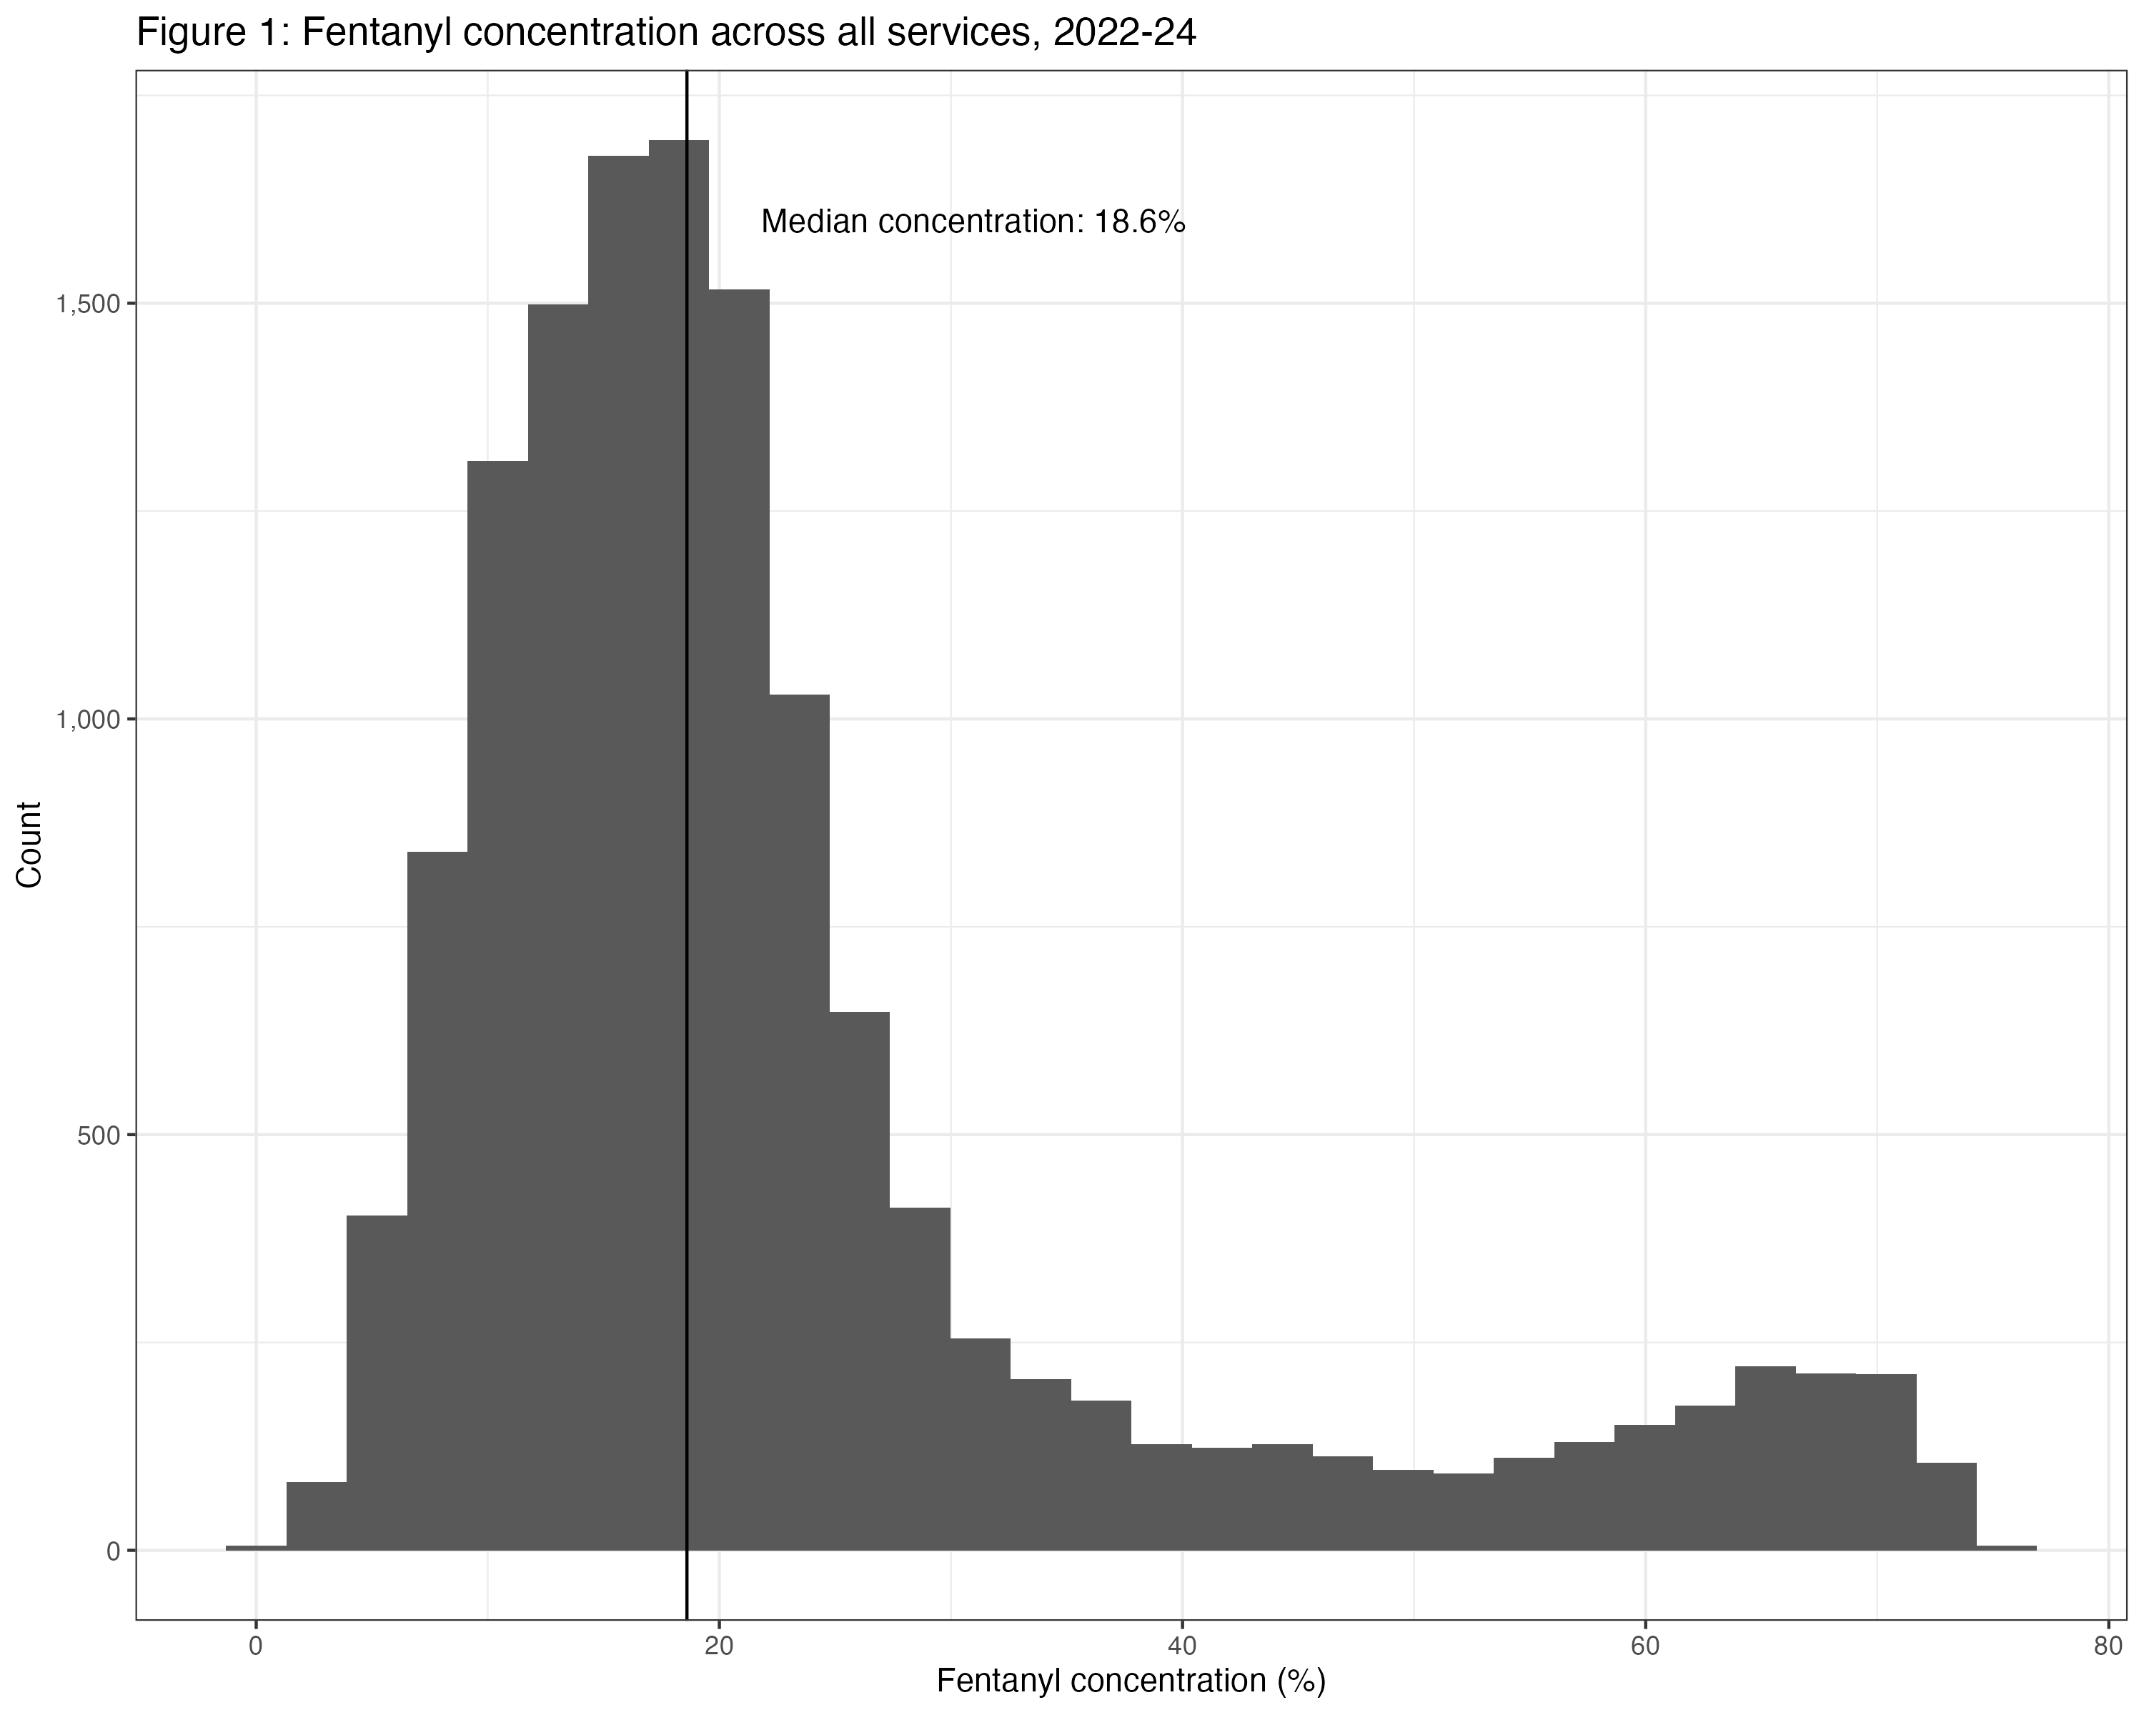
Notes:
Pretty heavy right skew
Median concentration about 18.6%
Bimodal distribution

Slide 14
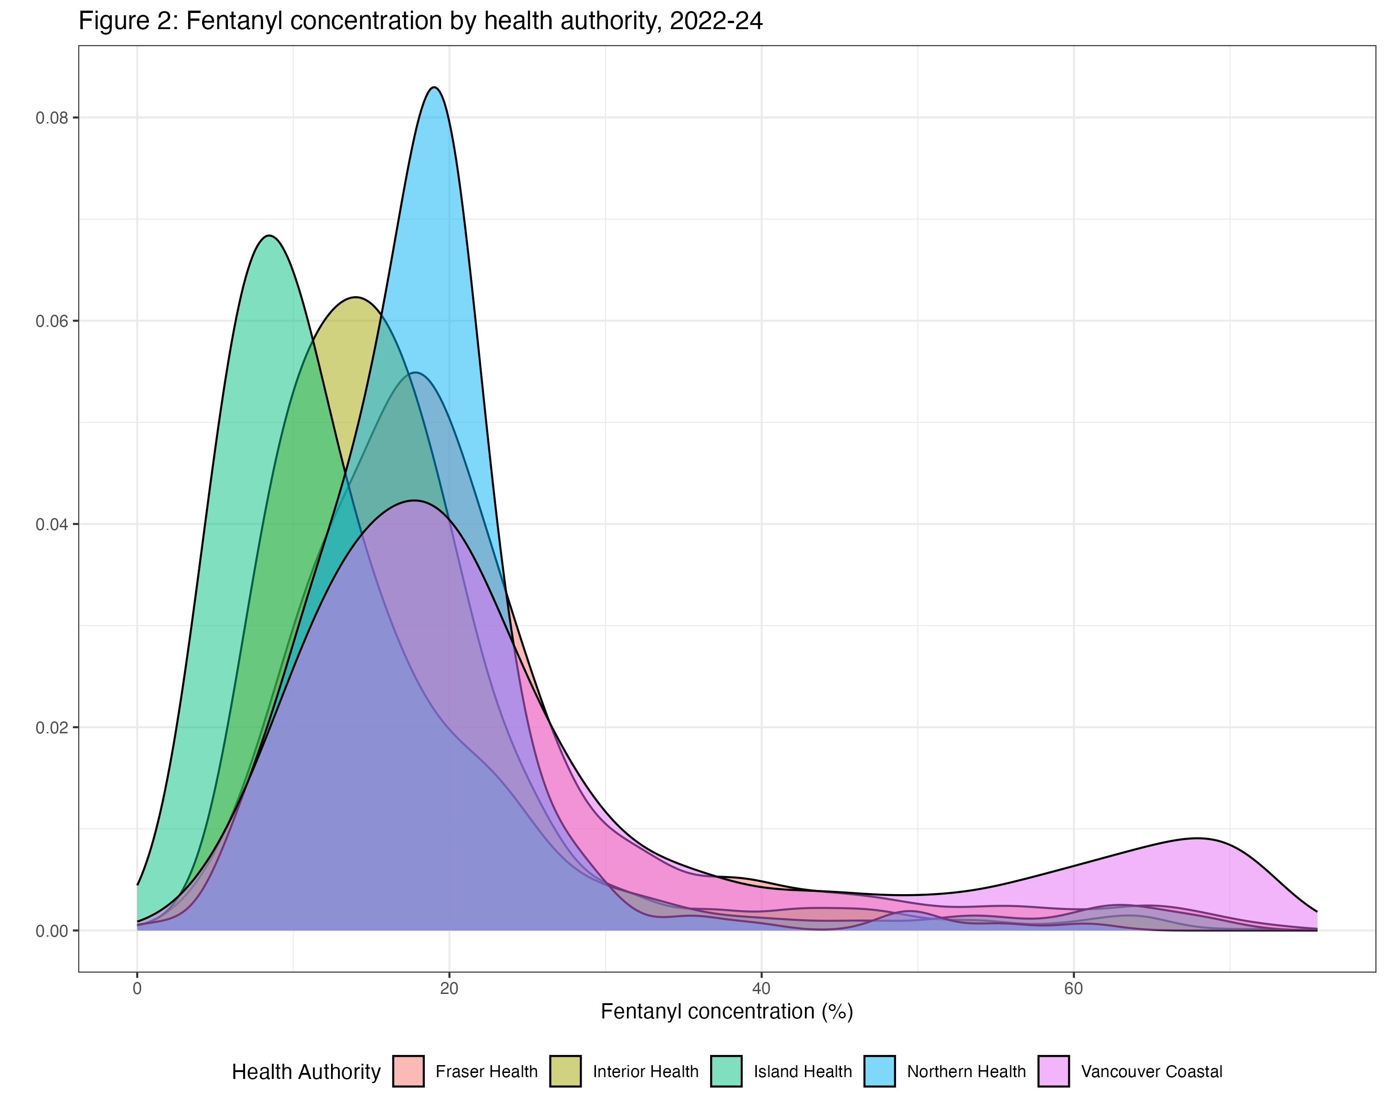
Notes:
Density plot is disaggregated by health authority. The skew is also present here, and the densities for each are clustered fairly closely around each other. However you can see that only one of this has this hump on the right side. Did some digging and that was actually a single service. So what we have decided to do is disaggregate for further analysis

Slide 15
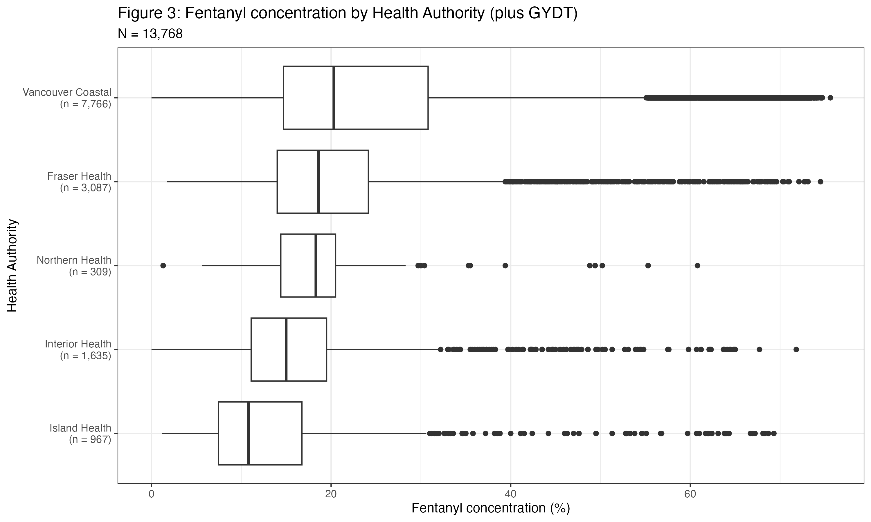

Notes:
This is the same data visualized in a boxplot, and ordered by median fentanyl concentration. As you can see for each of the Health authorities the interquartile ranges are fairly similar and fairly narrow. However for GYDT there is much more variability. It also has the highest median fentanyl concentration – when that is split out from its parent HA, Vancouver coast actually has the third highest median fentanyl concentration, below Northern and Fraswer health.
Something else I want everyone to pay attention to is the scale – so we have nearly 14,000 samples, and GYDT accounts for nearly a third of those. By comparison there are far fewer samples tested in both Island health and especially northern health. Just something to keep in mind

Slide 16
RESULTS – Over time

Slide 17
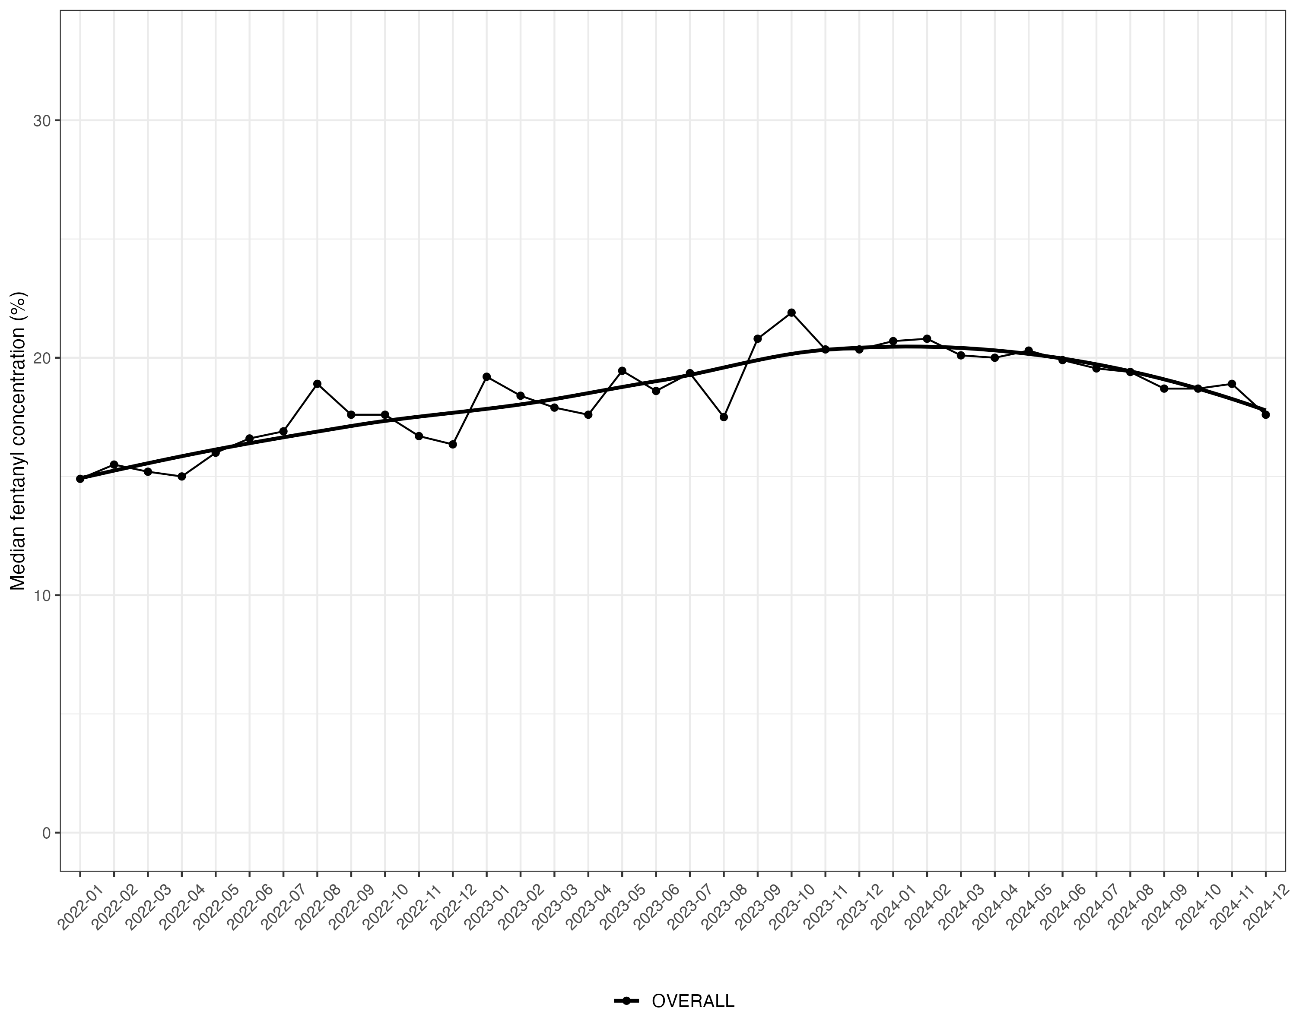
Notes:
Concentration change across the whole time series, with a regression line fitted. Slow and steady increase

Slide 18
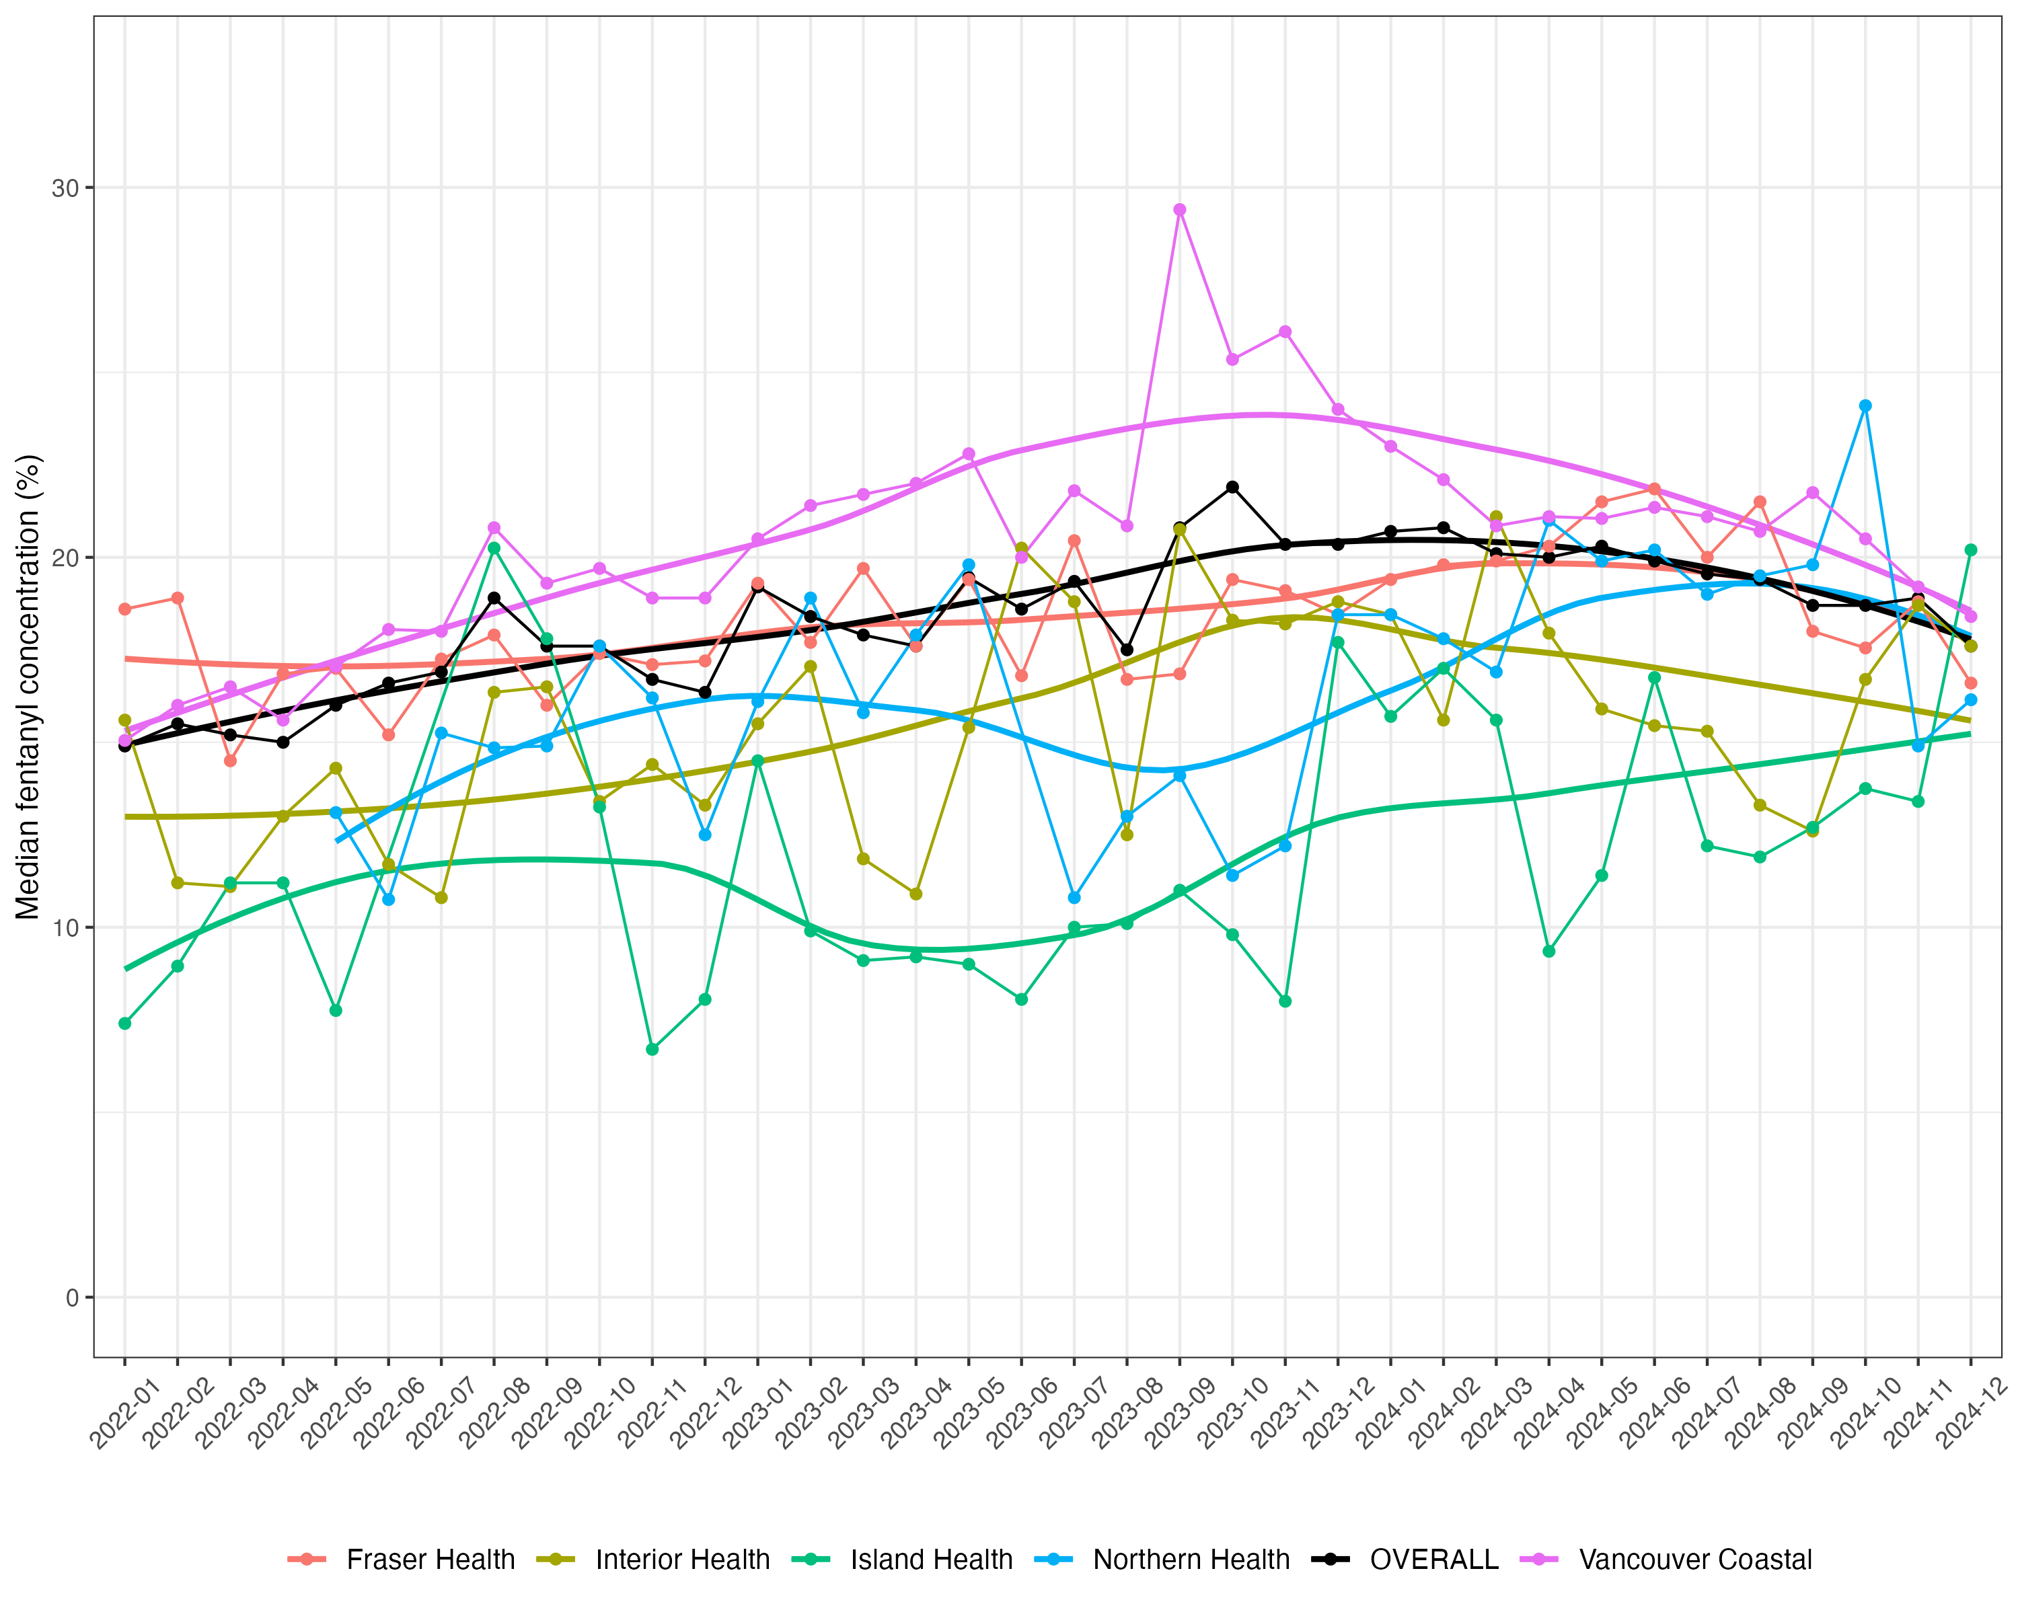

Slide 19
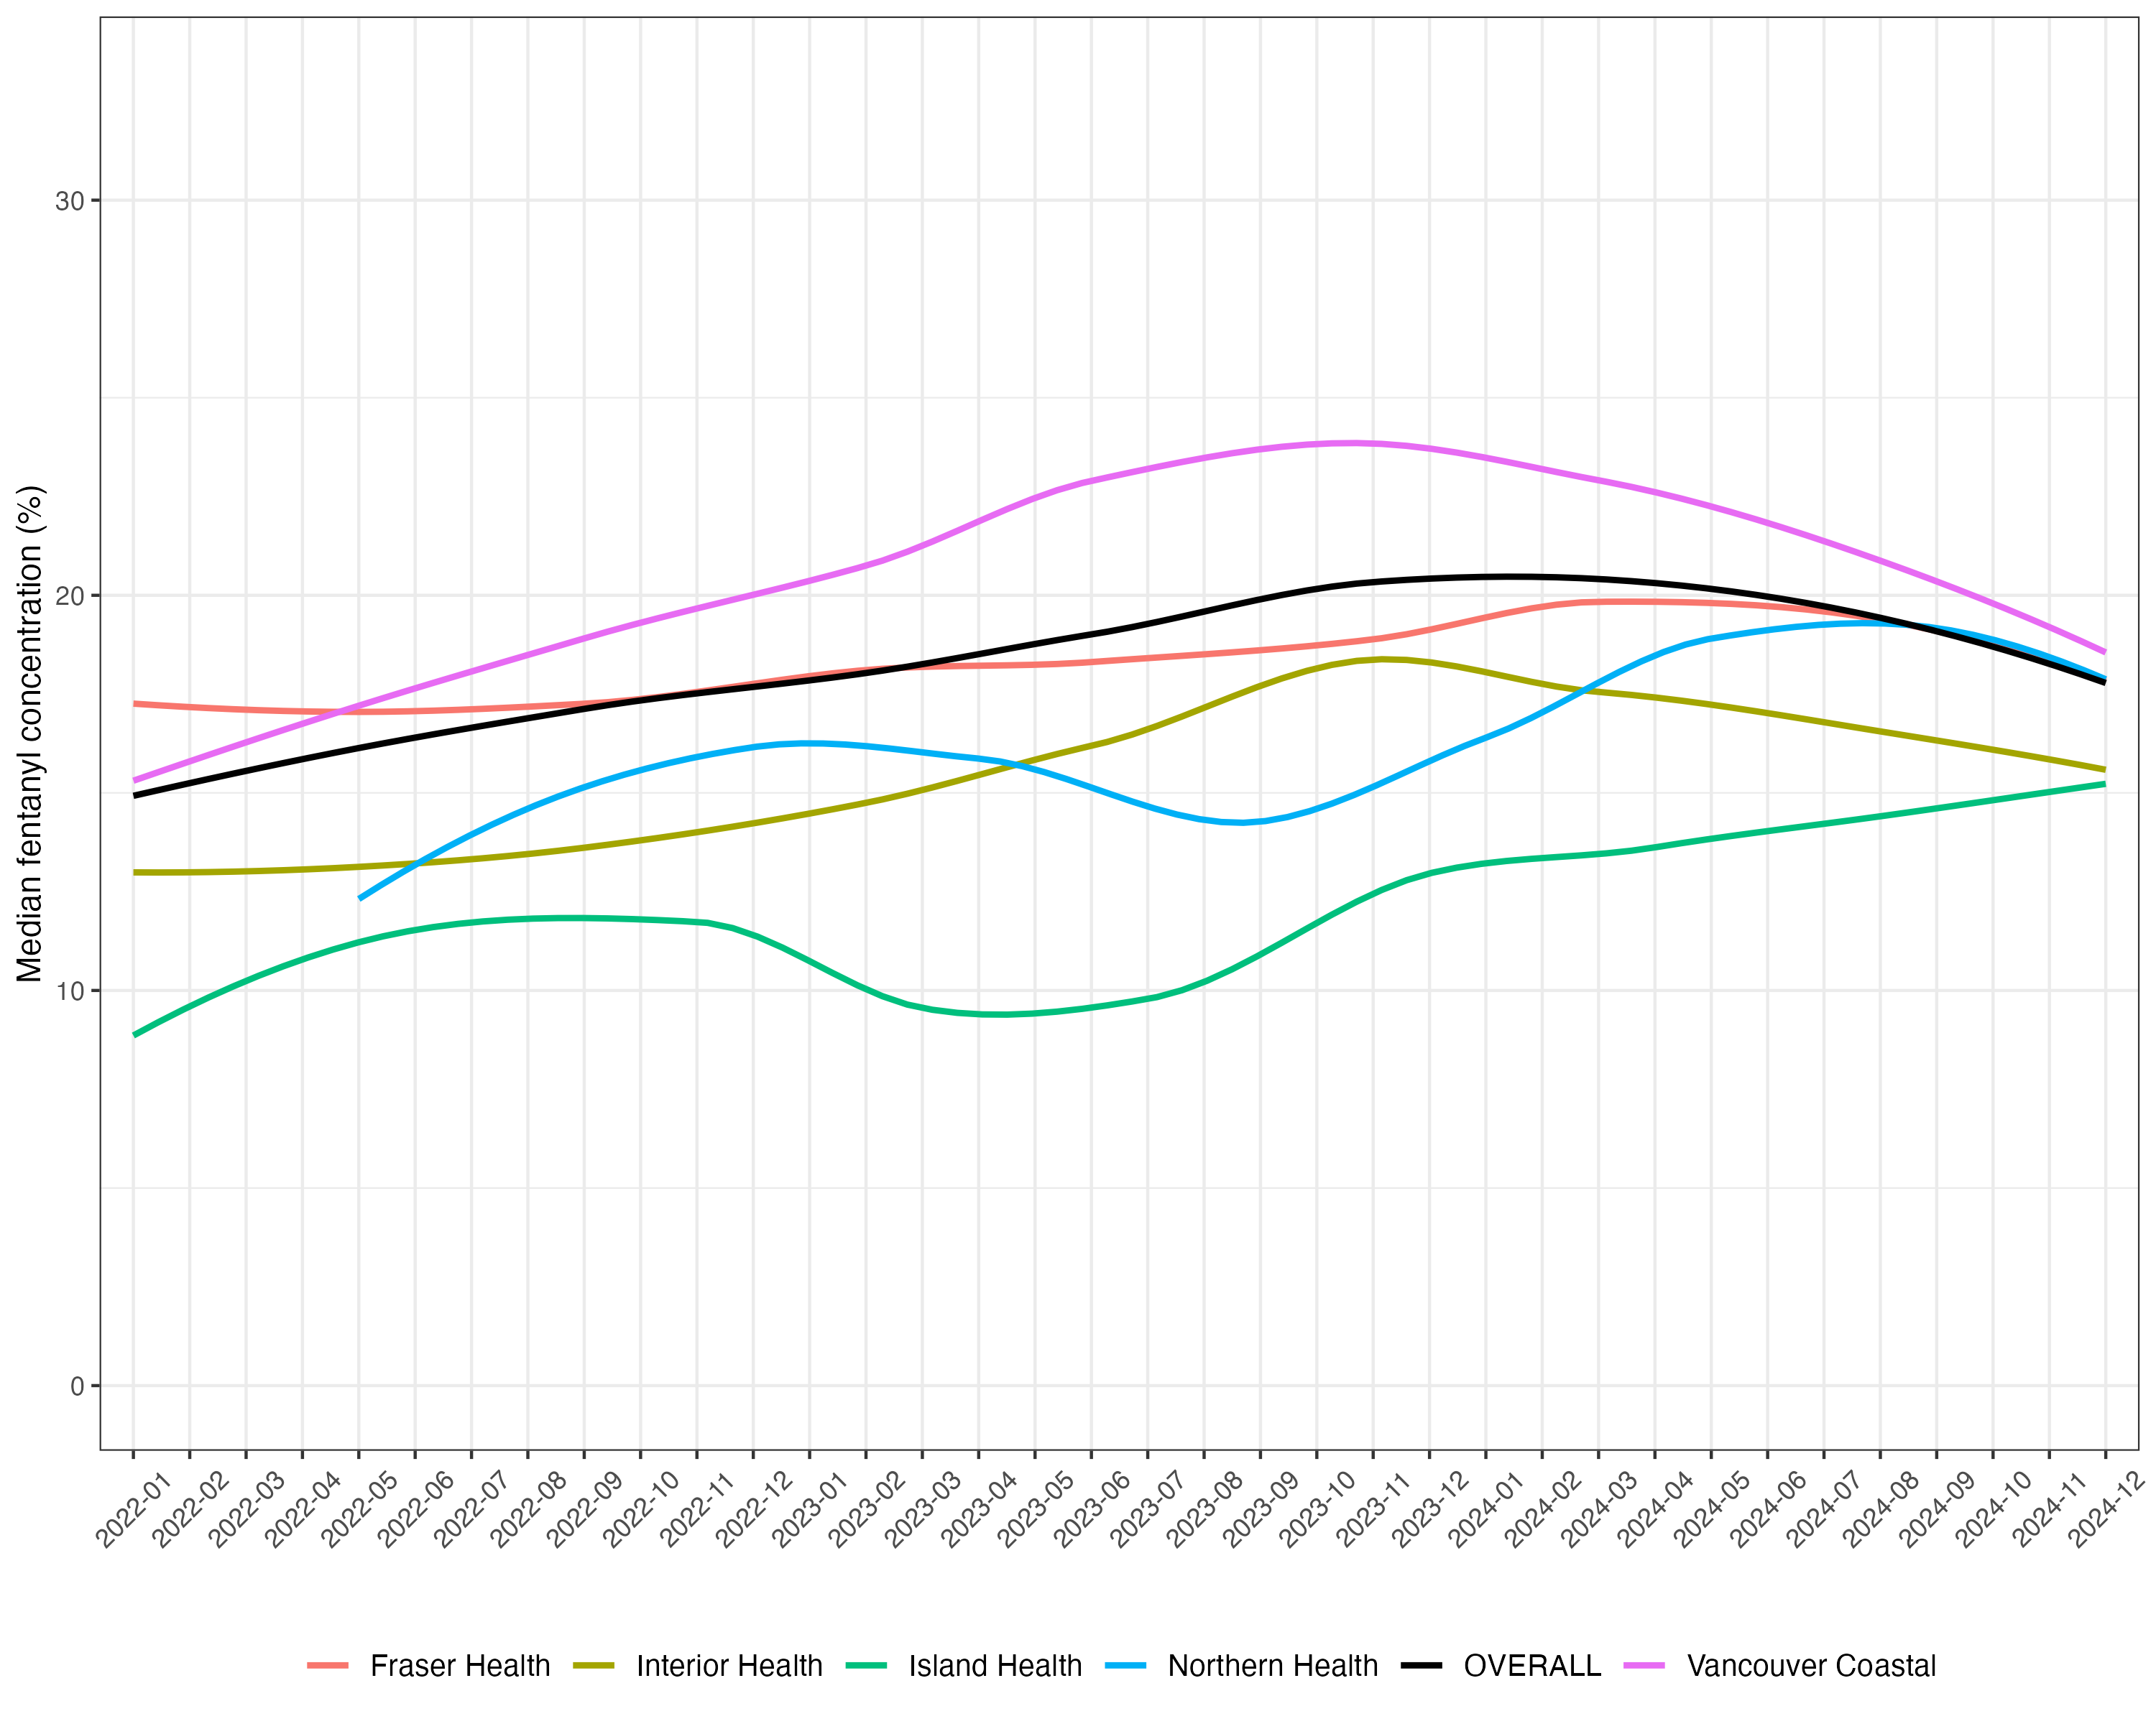
Notes:
Here a slightly different picture emerges Same as before, pay attention to the slope. Median rates in Fraser have been bang on. But it appears that Vancouver coastal has had a swifter rate of increase. Partially explained by the tremendeous spike between August and December 2023. d

Slide 20
Interim results – Health Authority over time
Increases in monthly median concentration may have plateaued
Trends in HAs are similar to provincial picture
Except Island Health Authority
General trend seems to be of convergence

Slide 21
RESULTS – Rural/urban
Notes:
Used rural urban index published by Statistics Canada. Analysis will look similar to what was just presented

Slide 22
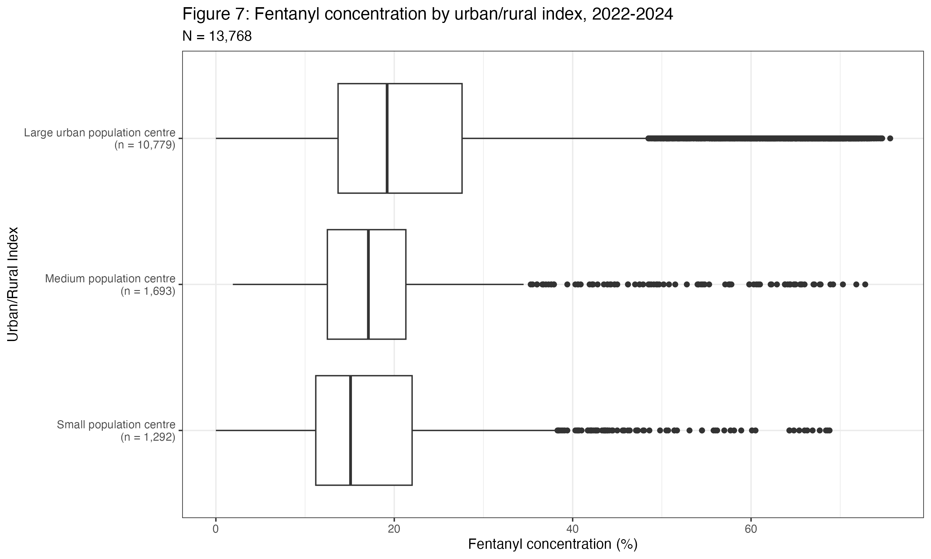
Notes:
Rural urban index
Large population centres comprise the bulk of locations where samples were collected, accounting for ~80%
Large >100k (Vancouver, Nanaimo)
Medium 30k-99,999 (Chilliwack, Prince George)
Small 1000-29,999 (Hope, Nelson, Squamish

Slide 24
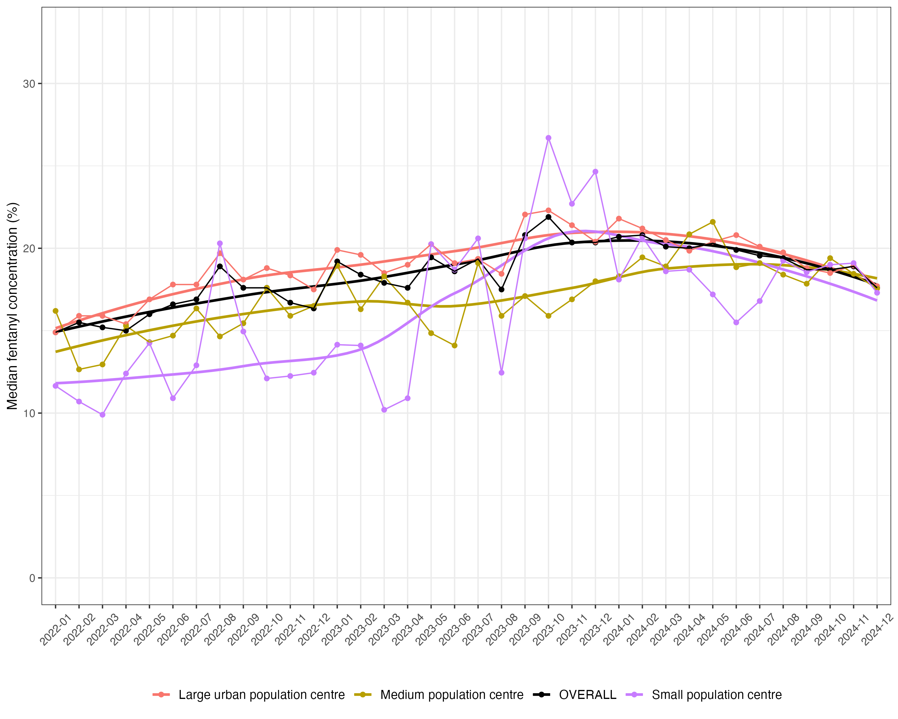
Notes:
As before, GYDT and OVERALL are more or less identical in slope, albeit the former is obviously higher. But pay attention to what’s going on below the line here. The green, gold and magenta lines are the three urban/rural classifications. At the beginning there is a noticeable spread between them. However as the time series preogresses they gradually converge, such that by December 2024 they are nearly on top of one another. What was a separation of about five percentage points in median concentration shrunk to a difference of less than one percentage point

Slide 25
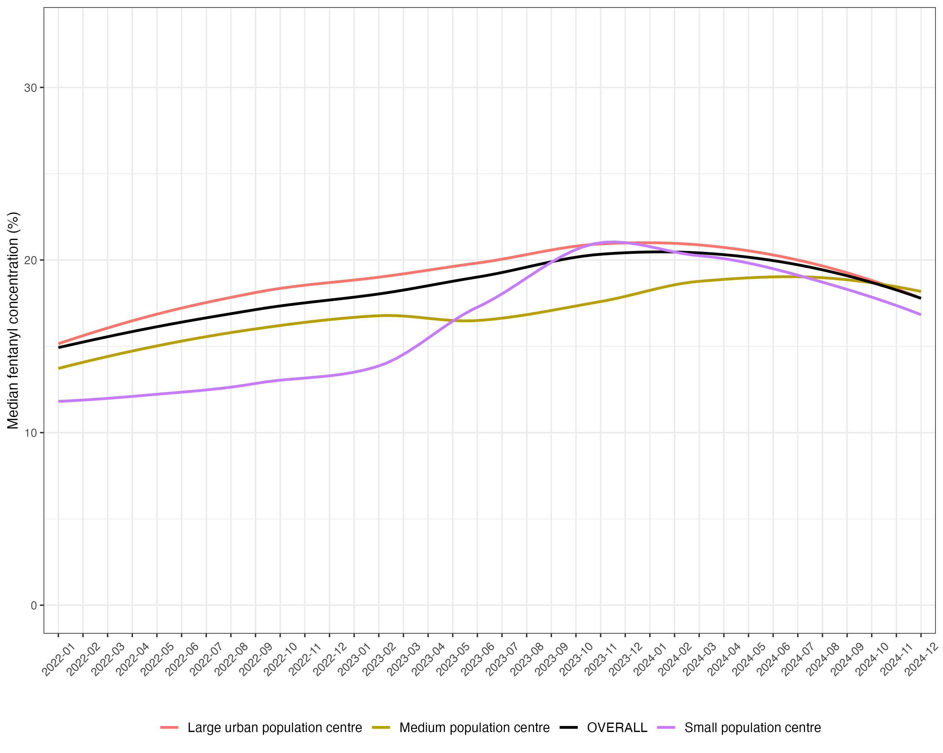
Notes:
Near convergence; spike in small population centres.

Slide 26
Interim results – Rural/urban over time
Monthly median concentration is similar
General trend seems to be of convergence

Slide 27
RESULTS – Health Service Delivery Area
Notes:
Have showed you results by health authority and urban/rural, but we have this data to the postcode level, so I sought to beter understand

Slide 28
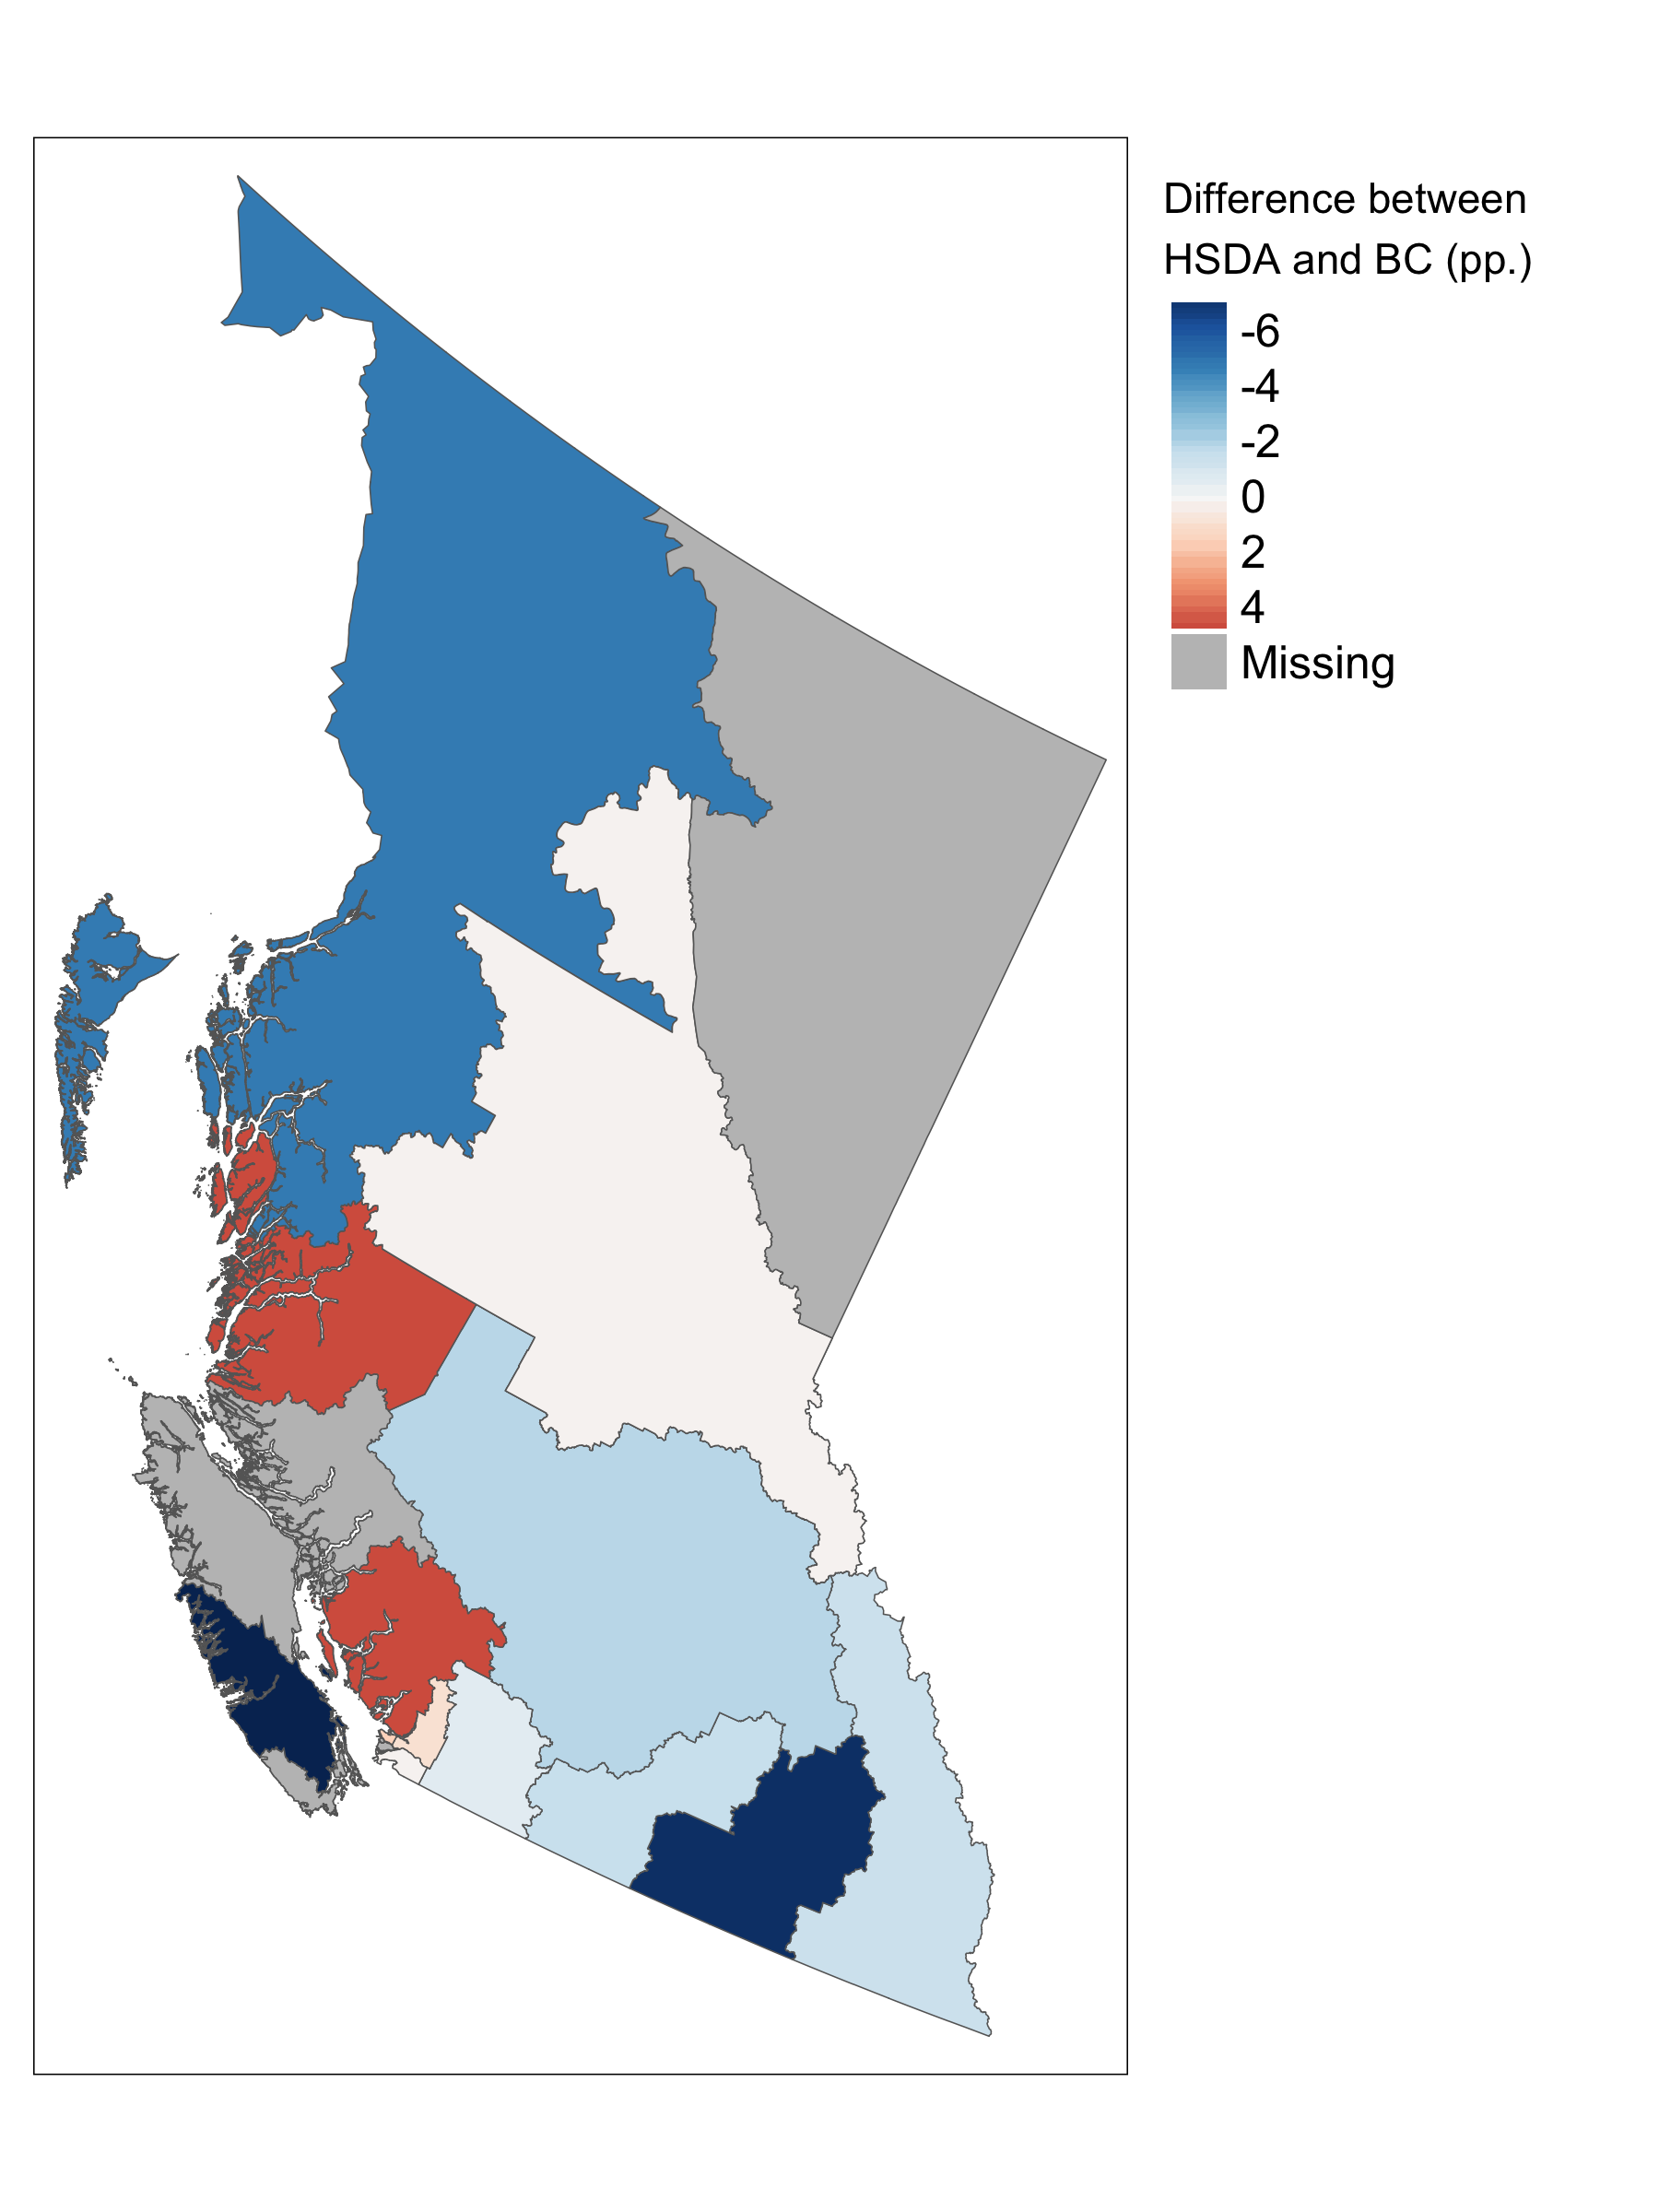
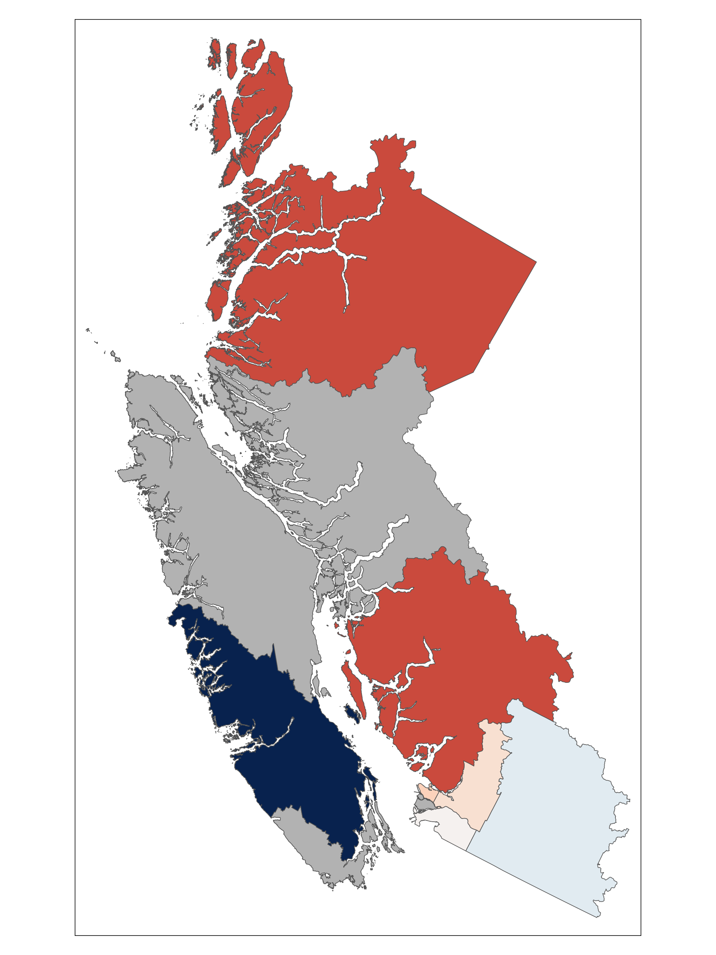
Median fentanyl concentration (BC): 18.6%

Slide 29
Median fentanyl concentration (BC): 18.6%
Northern Interior: 18.8% (+0.2pp.)

Slide 30
Median fentanyl concentration (BC): 18.6%
Northern Interior: 18.8% (+0.2pp.)
Kootenay-Boundary: 11.3% (-7.3pp.)

Slide 31
Median fentanyl concentration (BC): 18.6%
Northern Interior: 18.8% (+0.2pp.)
Kootenay-Boundary: 11.3% (-7.3pp.)
Vancouver: 20.1%
(+1.5pp.)

Slide 32
Median fentanyl concentration (BC): 18.6%
North Shore/Coast Garibaldi: 23.3% (+4.7pp.)
Northern Interior: 18.8% (+0.2pp.)
Kootenay-Boundary: 11.3% (-7.3pp.)
Vancouver: 20.1%
(+1.5pp.)

Slide 33
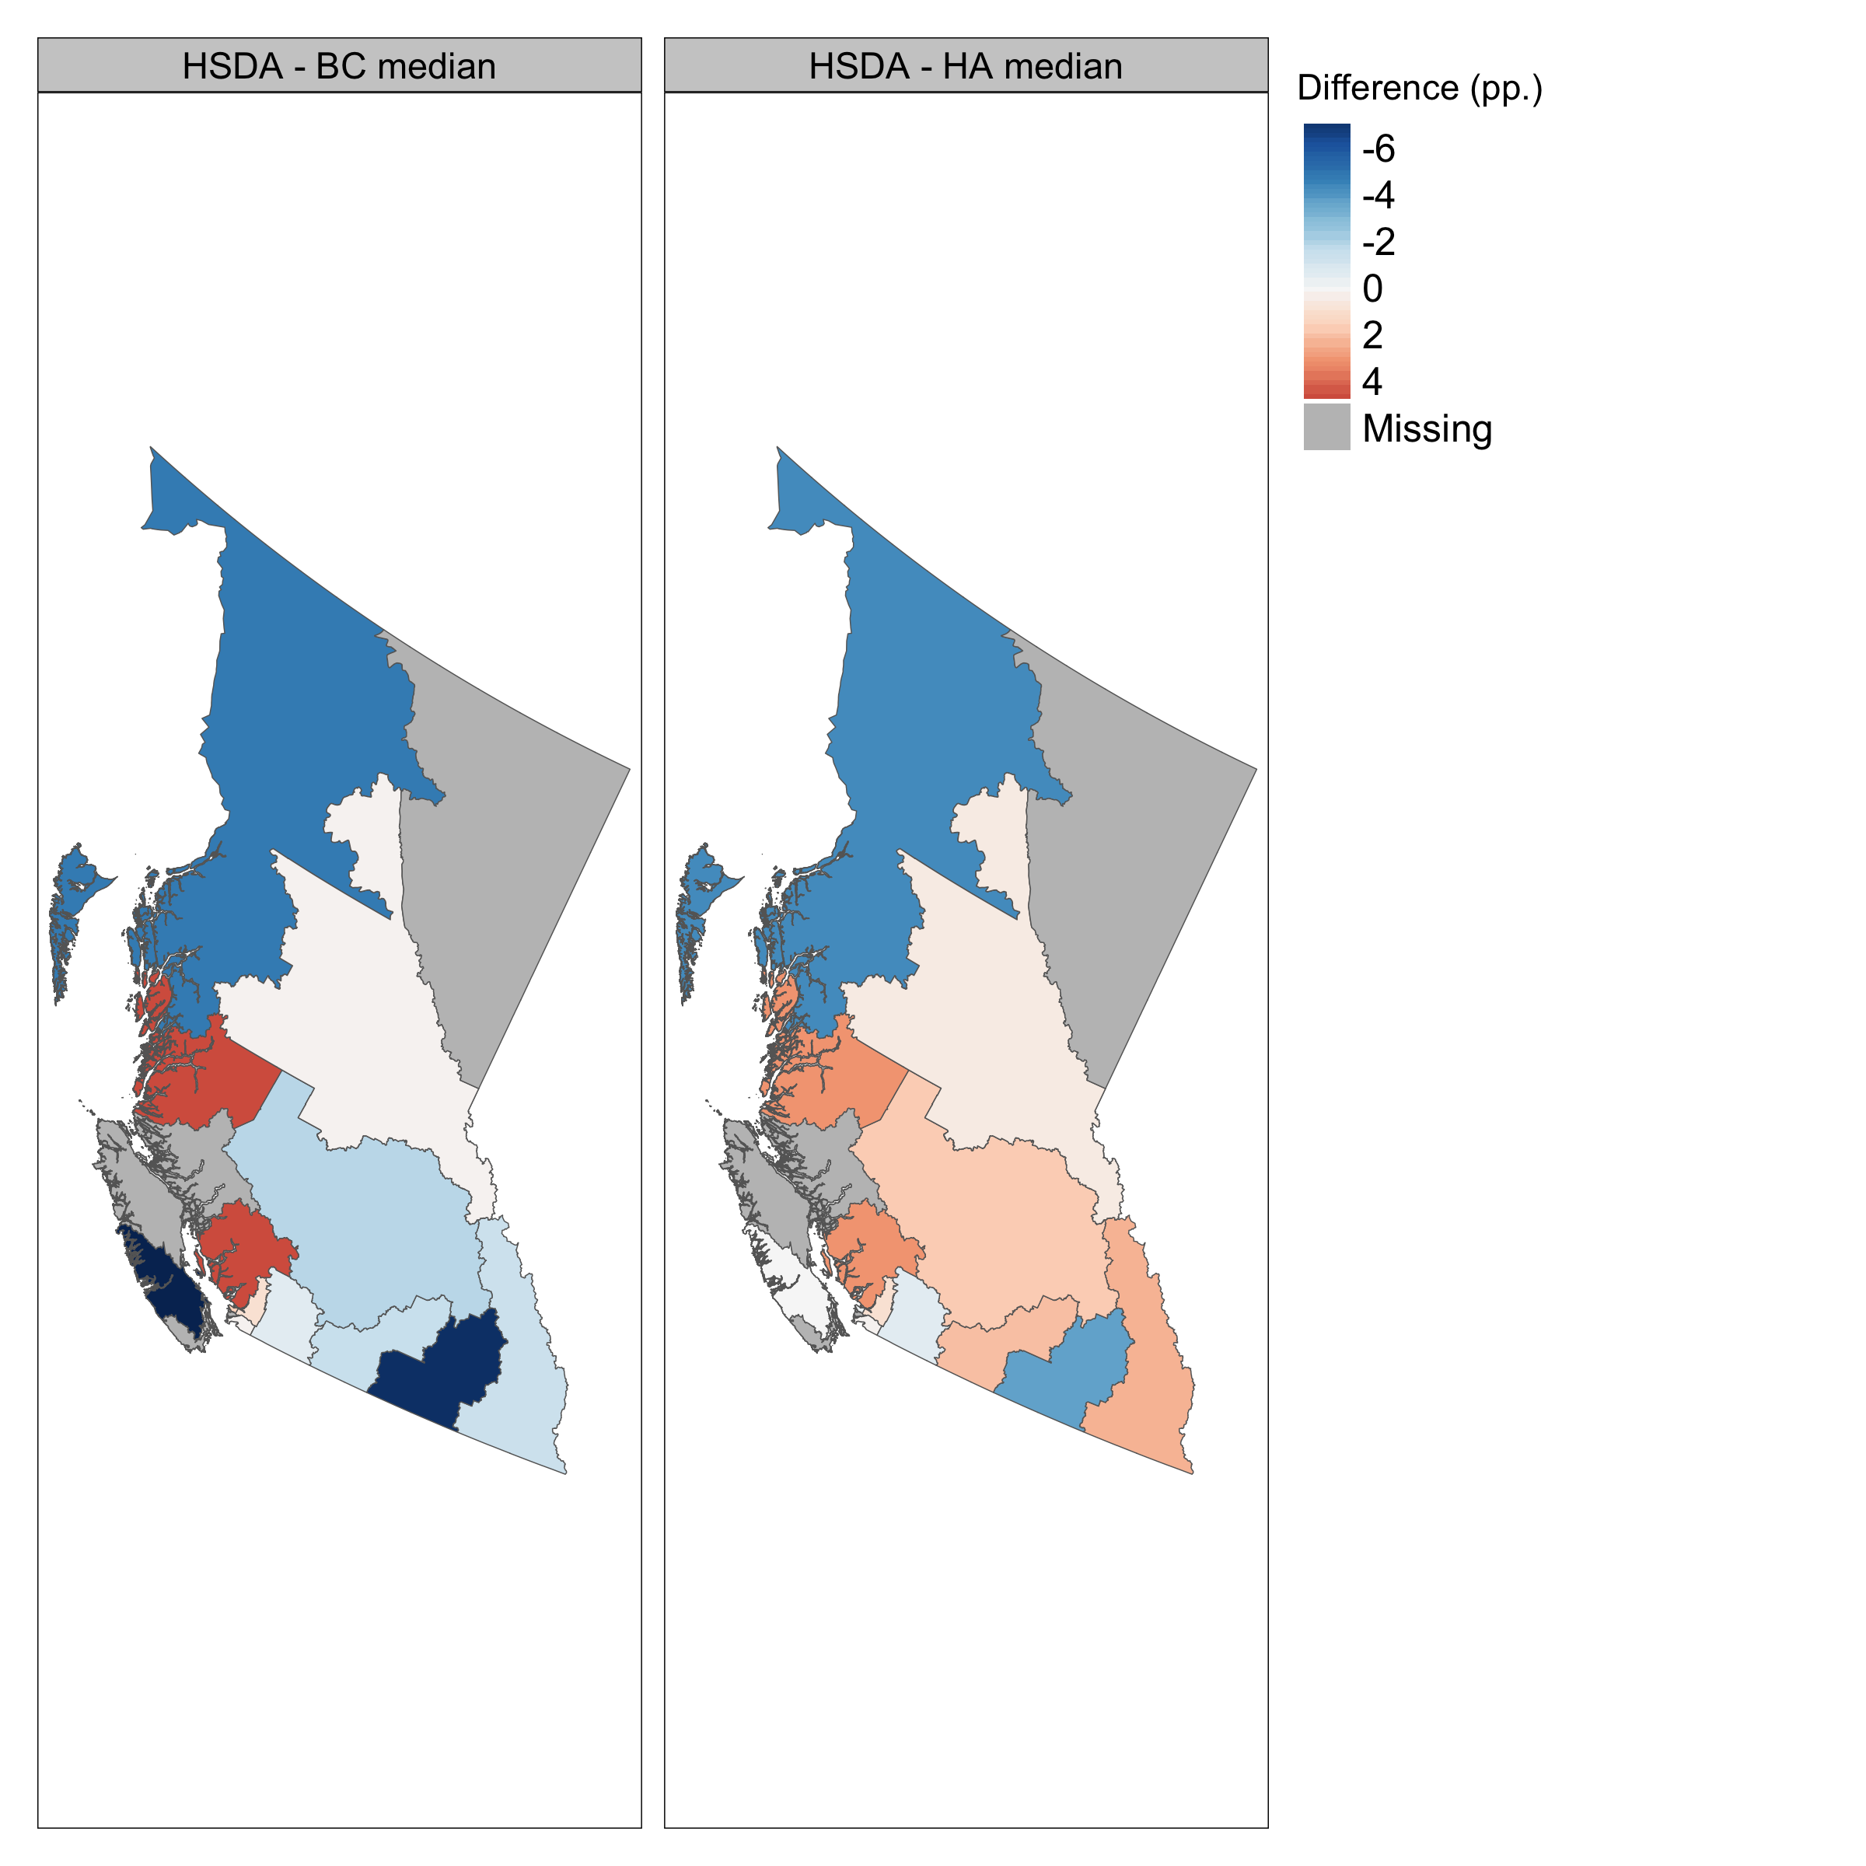

Slide 34
Conclusions
Fentanyl concentration has risen (slightly)
Increases have been fairly stable across the province
Differences between rural/urban areas may be shrinking
Comparisons differ depending on level
Drug checking = valuable monitoring tool

Slide 35
Limitations
Descriptive study
Does not capture analogues/ account for adulterants
Does not include mail-in samples
May not be representative of wider unregulated drug supply
Underscores need for universal access to DCS
Notes:
I think the other point to make either here or elsewhere is that we are making a big assumption that the drug supply is reflective of the geographic area that the sites are located in. Like for example, there’s only one site in the NHA region, so we’re making the assumption that the supply within that area is reflective of ppl who bring drugs to that site, where we know that the NHA region is so large that that may not be true.

Slide 36
Acknowledgements
Thanks to those individuals who participated directly in the study by having their drugs analyzed, with the hopes that this involvement will contribute to utilizable public health information, improved harm reduction care, and potentially, decreased loss of life. We would also like to thank researchers and staff at various community organizations, health authorities, and laboratory services across British Columbia for their work in this area.

Slide 37

Joshua.Bird@bccsu.ubc.ca

